Slide 1
Setting Up Infinite Campus Grade Book (4th & 5th Grade)

Slide 2
Categories & Grade Calculations
There are two categories
Formative Assessment (50%)
Summative Assessment (50%)
Categories can be added to ALL classes one time.
Shared classes make certain you create only ONE Formative and ONE Summative category for each class.
Grade calculations are set ONE time for EACH class you enter grades.
Changing “sections” allows you to set each class up.
This process locks the calculations for averaging the gradebook within the system to calculate averages from grades for 9 week report card grades, semester grades, and final grades.

Slide 3
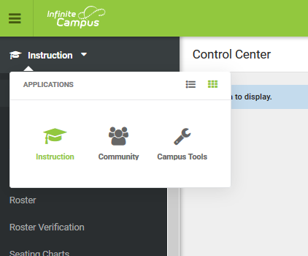
Categories

Slide 4
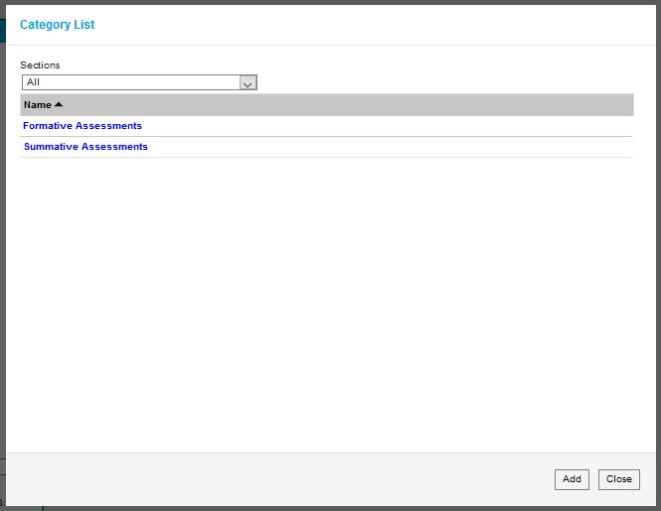
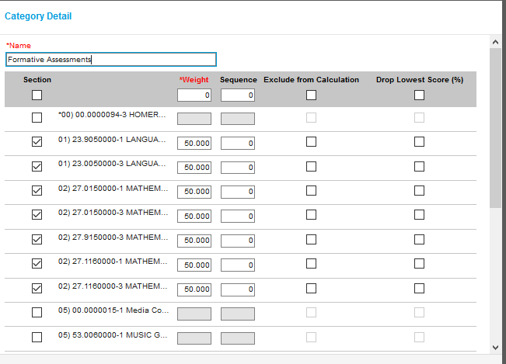
Set Category
Set @ 50
Type Formative Assessment
Type 50.
Check all of the classes served

Slide 5
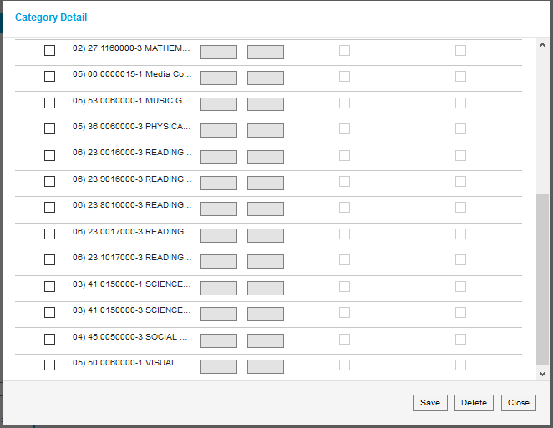
Press Save & Repeat for Summative Assessment

Slide 6
Grade Calculations
Choose class

Slide 7
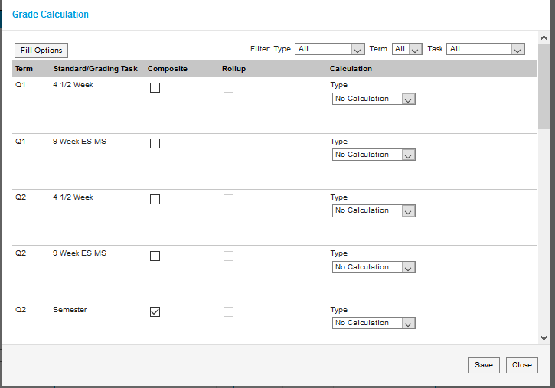
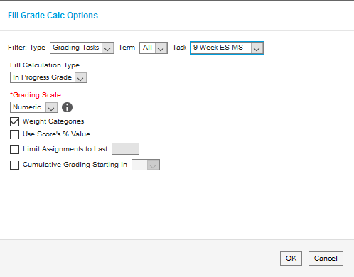
“Fill All” for each Grading Task
Press Save!

Slide 8
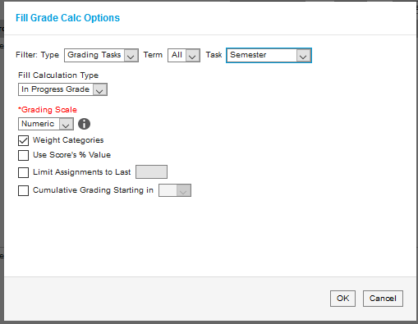
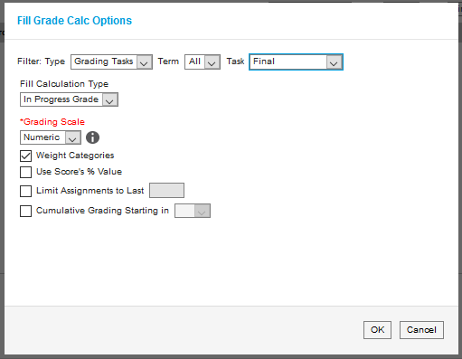
Repeat the same process for Semester and Final Grade Calculations
Do not forget to complete these steps for EACH class (section)!!

Slide 9
You are now ready to add assignments to the gradebook!

